Slide 1
Alström Syndrome UK
Annual General Meeting 2017-2018
24th January 2019

Slide 2
Welcome
Michelle Hough - outgoing Chair of Alström Syndrome UK
Trevor Parkin - Interim Chair Of Alström Syndrome UK
Introduction and purpose of this AGM

Slide 3
Agenda
Introductions
Apologies
Minutes from the last AGM
Any matters and actions arising from the minutes
The Financial Report
The Annual Report
Achievements and Challenges in 2017-2018
Trustees-Election and re-election
Resolutions
AOB

Slide 4
Agenda
Apologies
Minutes from the last AGM
Any matters and actions arising from the minutes

Slide 5
Financial Report 2017 – 2018
Financial Reporting for 2017 to 2018
Finance Manager Steve Scoffield

Slide 6
Income
2017 – 2018 - £198,000
2016 – 2017 - £205,00

Slide 7
Income
NHS - £133,000
Children in Need - £23,000
Breaking Down Barriers - £20,000
General funds - £20,000

Slide 8
Expenditure
2017 – 2018 - £244,000
2016 – 2017 - £200,00

Slide 9
Additional spend on
Full year for new staff including CEO and family support workers
Raising awareness including scientific symposium & ASUK Conference. Presenting and attendance at international conferences

Slide 10
Financial Position
ASUK finances are healthy, we are working on funding to maintain our reserves
General Funds - £107,000

Slide 11
Independent Examiner's Report to the Trustees of Alström Syndrome UK
Accounting records comply with Act & SORP
No matters to draw members attention to

Slide 12
Annual Report
Trevor Parkin - Chair and Treasurer

Slide 13
Annual Summary
We supported 73 families
68 children & adults attended 13 AS clinics
We visited 46 families at home
We visited 11 children in School or College
78 people (known to us) have AS. Most professionals will never meet a patient with AS because it is an ultra-rare disease
100% of families who completed evaluation forms told us they were ‘happy’ or ‘very happy’ with the AS clinics & ASUK Support Services
‘Moving on Up’ 6 young people were supported in preparation to move onto adult services
Breaking Down Barriers worked with 12 rare disease organisations

Slide 14
Annual Summary
Thanks to Children in Need Funding:
  30 families joined in Foodie Friends Clubs
  14 visually impaired young people enjoyed a ‘once in a lifetime’ driving experience
  3 families took part in horse riding adventures
For the year 2017/18 there were 6 Trustees on the Board of ASUK
7 people work for ASUK, supporting families, promoting research and raising awareness
We gave grants to 4 families
We gave 4 items of exercise equipment/ gym membership
Our website reached 28,000 views from 107 countries
Our ‘Living with a Rare Disease’ animation helped to raise awareness of AS reaching an incredible 2,300 views.

Slide 15
People with Alström Syndrome

Slide 17
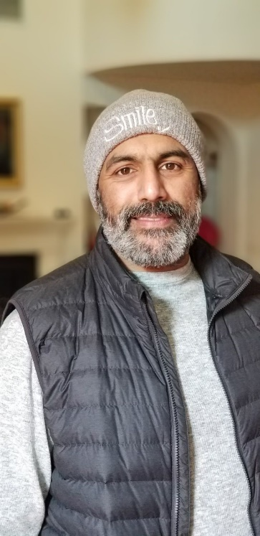
Election of new Trustees
Parminder Jutla
Parminder Jutla joined the ASUK Board of Trustees in March 2018. He brings extensive experience and knowledge and is a welcome addition to the board
His experience includes developing programmes that have received grant funding
He has fundraised from a variety of sources to deliver local, national and international support and resource services for social entrepreneurs, local organisations and community groups
He also has experience planning and undertaking voluntary sector project evaluations.

Slide 18
Trustees standing down
Rick Steeds
Dr. Rick Steeds joined the board in March 2018. On 4th December 2018 he stood down as an ASUK trustee
We are extremely appreciative for his input to date and would welcome him should he wish to return at any point in the future.

Slide 19
Re-election of Trustees
Trustees
Dawn Mayes Michelle Hough Alex Griffiths-Rayson Kez Hayat Parminder Jutla Trevor Parkin Dr. Richard Paisey
Re-election nominations
Dawn Mayes-Vice Chair

Slide 20
Conclude
AGM 2017-2018
Resolutions
Any other Business?
Questions?

